Slide 1
INVESTMENT CASE STUDY SUBMISSION
Group Name:
Harathi Pavankumar
Pushpendra Sharma
Maya Kavuri
Puja Chakraborty

Slide 2
As a data analyst team we are helping Spark funds to understand the global trends in investment and take the decisions effectively. We have analyzed the best three English speaking countries and the top sectors where Spark funds can invest 5 to 15 million USD amounts per rounds investment.
We have taken real investment data from crunchbase.com and analysed three files having data count 114950 ,66369 and 668 rows of data respectively containing information for countries ,sectors ,investments amount, region ,states etc.
In order to analyze the trends of investments in each country and sector we had to do a thorough cleaning of data and used only data that is most important for analysis.
We have found the top three countries and top three sectors in each of these countries with a suitable investment type that would be appropriate for Spark funds to invest with a cap of 5 to 15 million USD per round of investment.

Slide 3
>
Load 1st file :companies
Load 2nd file:rounds2
Inspecting :Rows count,columns counts,null count s and encoding issue and special characters
Data cleaning:Resolve the encoding issue
Data Collection
Inspecting :Rows count,columns counts,null countand encoding issueand special characters
Data cleaning:Remove null
Analyze:Checkpoint 1.1:Unique company,Unique key
Data analyze:1.1:Unique company,Unique ,companies rounds data frames has same company
Master frame
Inspecting :Rows count,columns counts,null count s
Data cleaning:Remove null,dropping unwanted coloumn
Data cleaning:Remove null,dropping unwanted coloumn
5.1:company received the highest investment,Top three sector in top 3 countries.
Inspecting :Rows count,columns counts,null count s
Merge with master and create final frame
Load mapping file
Analize Checkpoint 2.1 :Most suitable investment type.
Checkpoint 3.1:top nine countries (based on the total investment and top 3 english speaking country

Slide 4
Analysis of data files
Investment type analysis:
1.Uploaded companies files,rounds2 files into Jupiter notebook. We observed some encoding issues in the file. So imported companies file using encoder :ISO-8859-1
2. Checked some top rows and the end rows of the file for analysing if there are any more encoding issue. Analyzed the number of rows and columns in the data frames
3. Checked all the column names, columns data types ,memory usage entries and also analysed the numerical Columns i.e. count of data, unique value count. count of NAN and a null values for individual columns for both companies and rounds2
7.We observed there were still encoding issues in one column ‘name’ in the loaded encoding file .So we removed the Unicode issue and make Python to treat string as UTF-8 not ASCII in companies file and removed all special character in rounds2 ‘company_permalink’ and converted all the data into lower case.
5.We have performed inner join between companies and rounds2 and created master data frame .
6.We checked row-wise Null count and removed null from ‘round_amount_usd’ and country_code also dropped 'funding_round_code','founded_at','region','city','state_code','homepage_url‘ etc.
7. Then we analyzed total investment wise count for each type of investments and also check and considering that Spark Funds wants to invest between 5 to 15 million USD we can see ‘venture’ is the best investment type for SPARK funds.

Slide 5
Country analysis:
We have analysed top 9 countries who has chosen venture investment type.
So based on the total investment amount we can see the below countries are in top 9 list.
3.Considering Spark investment wants to invest in only English speaking countries we can exclude CHN and conclude USA,GBR and IND are the best countries for investing in venture type.
USA | 420068000000.00
CHN | 39338920000.00
GBR | 20072810000.00
IND | 14261510000.00
CAN | 9482218000.00
FRA | 7226851000.00
ISR | 6854350000.00
DEU | 6306922000.00
JPN | 3167647000.00

Slide 6
3.Sector analysis:
1.We have created one more data frame containing the information of eight main sectors. We have analyzed and observed there are some spelling mistakes in category name.
2.We dropped all then null values in category list in master data frame and mapped sector data frame and master data frame on the basis of category list. Also separated out the primary sector in master frame and rename as primary sector.
3.Finally we have joined master frame and sector frame on the basis of primary sector and category list. And finally we have dropped the null values from final data frame.
4.From the Final data frame we have created three individual data frames for top three countries and we observed sector ‘Others’ is the top sector for every three countries.
5.Also we observed company permalink is receiving highest amount in Others sector.

Slide 7
Plot -1

Slide 8
Plot 2
Total Investments in Top 9 countries

Slide 9
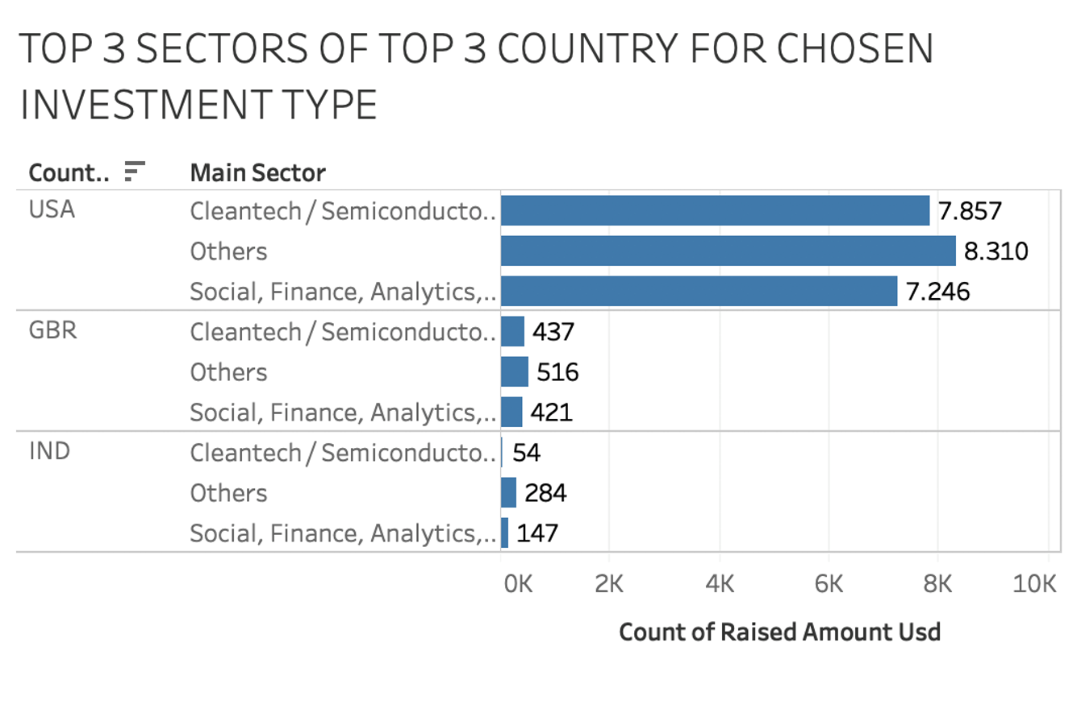
Investment sectors for top three English Speaking Countries
Plot 3

Slide 10
Conclusion
Based on Our analysis and conclusions we would like to advice Spark Funds, LLP CEO ,
To invest in USA, GBR and Indian companies as their investments destinations.
Private Equity Funding is the preferred funding round type for most of the companies that are looking for investments.
If Sparks offers money as Private Equity Funding there are high chances of fund being accepted by various companies thus opening a competition between multiple companies wanting for investments and Spark would be benefitted.
Trends show that Others , Social, Financial , Analytics and News , Search and Messaging areas should be the preferred set of investments sectors for most of the investments across the three countries suggested.

